Slide 1

Pseudocode
    If student’s grade is greater than or equal to 60
    Print “Passed”
If the condition is false, the Print statement is ignored, and the next pseudocode statement in order is performed.
Indentation
  Optional, but recommended
  Emphasizes the inherent structure of structured programs
The preceding pseudocode If in Java:
    if (studentGrade >= 60)
    System.out.println("Passed");
Corresponds closely to the pseudocode.
© Copyright 1992-2015 by Pearson Education, Inc. All Rights Reserved.

Slide 2
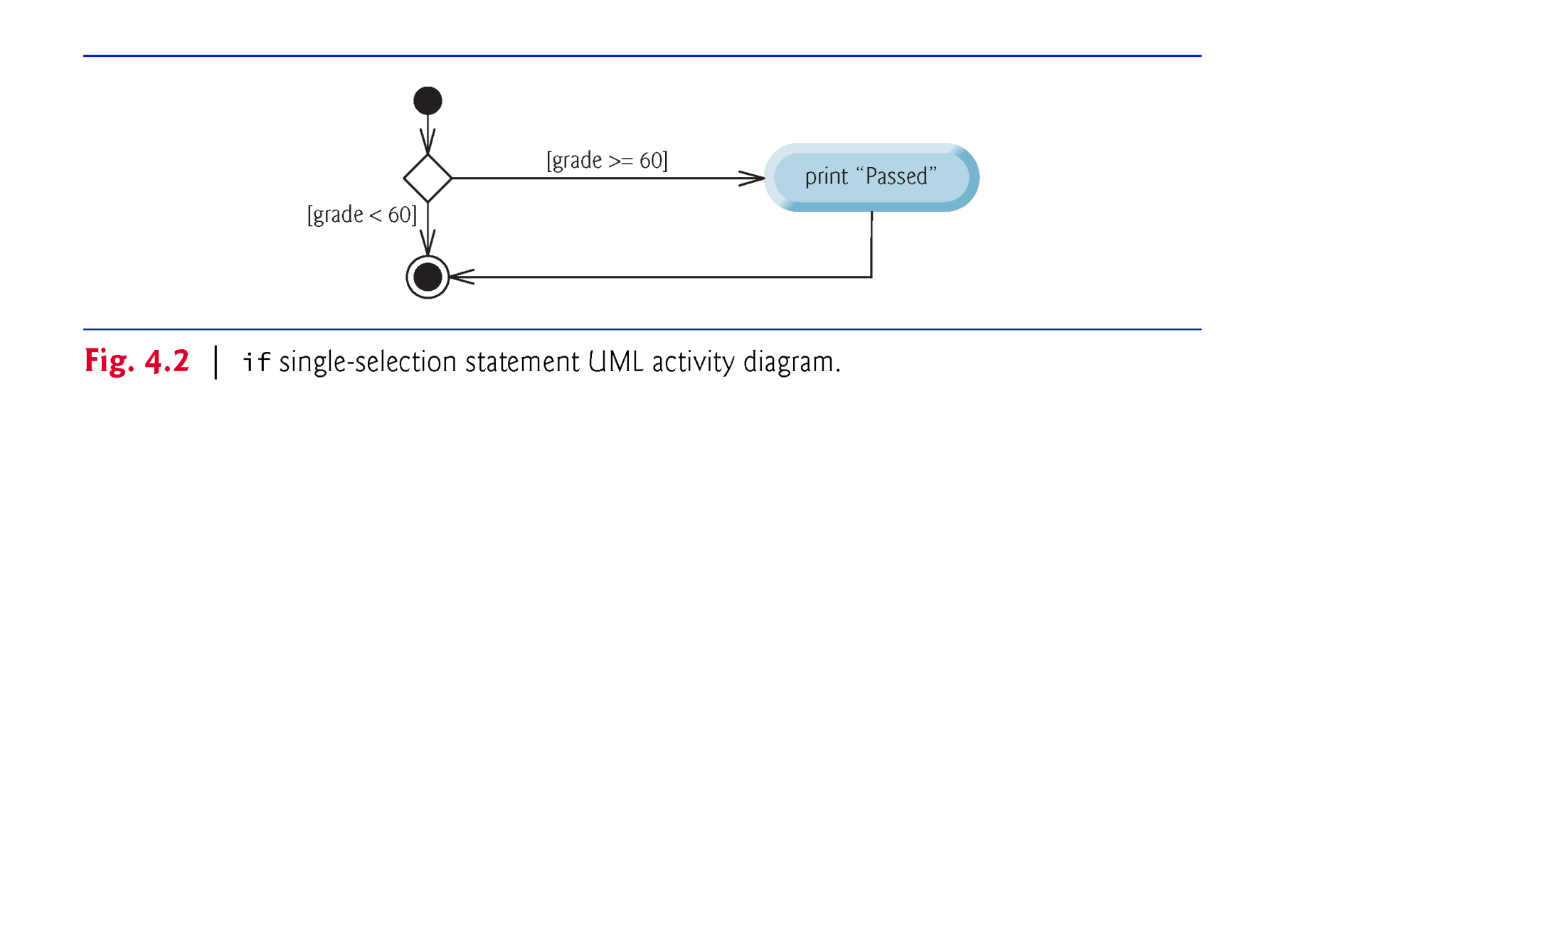
© Copyright 1992-2015 by Pearson Education, Inc. All Rights Reserved.

Slide 3

if…else double-selection statement—specify an action to perform when the condition is true and a different action when the condition is false.
Pseudocode
    If student’s grade is greater than or equal to 60
    Print “Passed”
    Else
    Print “Failed”
The preceding If…Else pseudocode statement in Java:
    if (grade >= 60)
    System.out.println("Passed");
    else
    System.out.println("Failed");
Note that the body of the else is also indented.
© Copyright 1992-2015 by Pearson Education, Inc. All Rights Reserved.

Slide 4
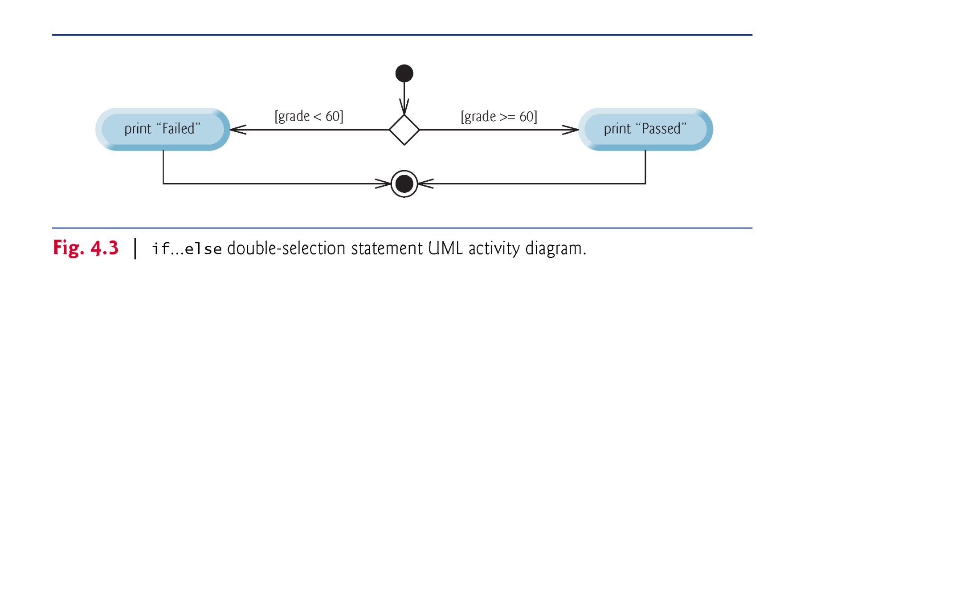
© Copyright 1992-2015 by Pearson Education, Inc. All Rights Reserved.

Slide 5

Nested if…else Statements
A program can test multiple cases by placing if…else statements inside other if…else statements to create nested if…else statements.
Pseudocode:
    If student’s grade is greater than or equal to 90
    Print “A”
    else
    If student’s grade is greater than or equal to 80
    Print “B”
    else
    If student’s grade is greater than or equal to 70
    Print “C”
    else
    If student’s grade is greater than or equal to 60
    Print “D”
    else
    Print “F”
© Copyright 1992-2015 by Pearson Education, Inc. All Rights Reserved.

Slide 6
This pseudocode may be written in Java as
    if (studentGrade >= 90)
    System.out.println("A");
    else
    if (studentGrade >= 80)
    System.out.println("B");
    else
    if (studentGrade >= 70)
    System.out.println("C");
    else
    if (studentGrade >= 60)
    System.out.println("D");
    else
    System.out.println("F");
If studentGrade >= 90, the first four conditions will be true, but only the statement in the if part of the first if…else statement will execute. After that, the else part of the “outermost” if…else statement is skipped.
© Copyright 1992-2015 by Pearson Education, Inc. All Rights Reserved.

Slide 7
Most Java programmers prefer to write the preceding nested if…else statement as
    if (studentGrade >= 90)
    System.out.println("A");
    else if (studentGrade >= 80)
    System.out.println("B");
    else if (studentGrade >= 70)
    System.out.println("C");
    else if (studentGrade >= 60)
    System.out.println("D");
    else
    System.out.println("F");
The two forms are identical except for the spacing and indentation, which the compiler ignores.
© Copyright 1992-2015 by Pearson Education, Inc. All Rights Reserved.

Slide 8
Dangling-else Problem
The Java compiler always associates an else with the immediately preceding if unless told to do otherwise by the placement of braces ({ and }).
Referred to as the dangling-else problem.
The following code is not what it appears:
    if (x > 5)
    if (y > 5)
    System.out.println("x and y are > 5");
    else
    System.out.println("x is <= 5");
Beware! This nested if…else statement does not execute as it appears. The compiler actually interprets the statement as
    if (x > 5)
    if (y > 5)
    System.out.println("x and y are > 5");
    else
    System.out.println("x is <= 5");
© Copyright 1992-2015 by Pearson Education, Inc. All Rights Reserved.

Slide 9
To force the nested if…else statement to execute as it was originally intended, we must write it as follows:
    if (x > 5)
    {
    if (y > 5)
    System.out.println("x and y are > 5");
    }
    else
    System.out.println("x is <= 5");
The braces indicate that the second if is in the body of the first and that the else is associated with the first if.
Exercises 4.27–4.28 investigate the dangling-else problem further.
© Copyright 1992-2015 by Pearson Education, Inc. All Rights Reserved.

Slide 10
Blocks
The if statement normally expects only one statement in its body.
To include several statements in the body of an if (or the body of an else for an if…else statement), enclose the statements in braces.
Statements contained in a pair of braces (such as the body of a method) form a block.
A block can be placed anywhere in a method that a single statement can be placed.
Example: A block in the else part of an if…else statement:
    if (grade >= 60)
    System.out.println("Passed");
    else
    {
    System.out.println("Failed");
    System.out.println("You must take this course again.");
    }
© Copyright 1992-2015 by Pearson Education, Inc. All Rights Reserved.

Slide 11
Conditional operator (?:)
Conditional operator (?:)—shorthand if…else.
Ternary operator (takes three operands)
Operands and ?: form a conditional expression
Operand to the left of the ? is a boolean expression—evaluates to a boolean value (true or false)
Second operand (between the ? and :) is the value if the boolean expression is true
Third operand (to the right of the :) is the value if the boolean expression evaluates to false.
© Copyright 1992-2015 by Pearson Education, Inc. All Rights Reserved.

Slide 12
Example:
    System.out.println(
    studentGrade >= 60 ? "Passed" : "Failed");
Evaluates to the string "Passed" if the boolean expression studentGrade >= 60 is true and to the string "Failed" if it is false.
© Copyright 1992-2015 by Pearson Education, Inc. All Rights Reserved.

Slide 13

Repetition statement—repeats an action while a condition remains true.
Pseudocode
    While there are more items on my shopping list
    Purchase next item and cross it off my list
The repetition statement’s body may be a single statement or a block.
Eventually, the condition will become false. At this point, the repetition terminates, and the first statement after the repetition statement executes.
© Copyright 1992-2015 by Pearson Education, Inc. All Rights Reserved.

Slide 14
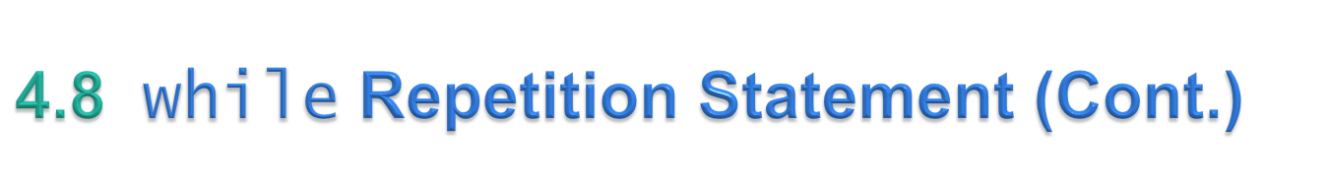
Example of Java’s while repetition statement: find the first power of 3 larger than 100. Assume int variable product is initialized to 3.
    while (product <= 100)
    product = 3 * product;
Each iteration multiplies product by 3, so product takes on the values 9, 27, 81 and 243 successively.
When product becomes 243, product <= 100 becomes false.
Repetition terminates. The final value of product is 243.
Program execution continues with the next statement after the while statement.
© Copyright 1992-2015 by Pearson Education, Inc. All Rights Reserved.

Slide 15
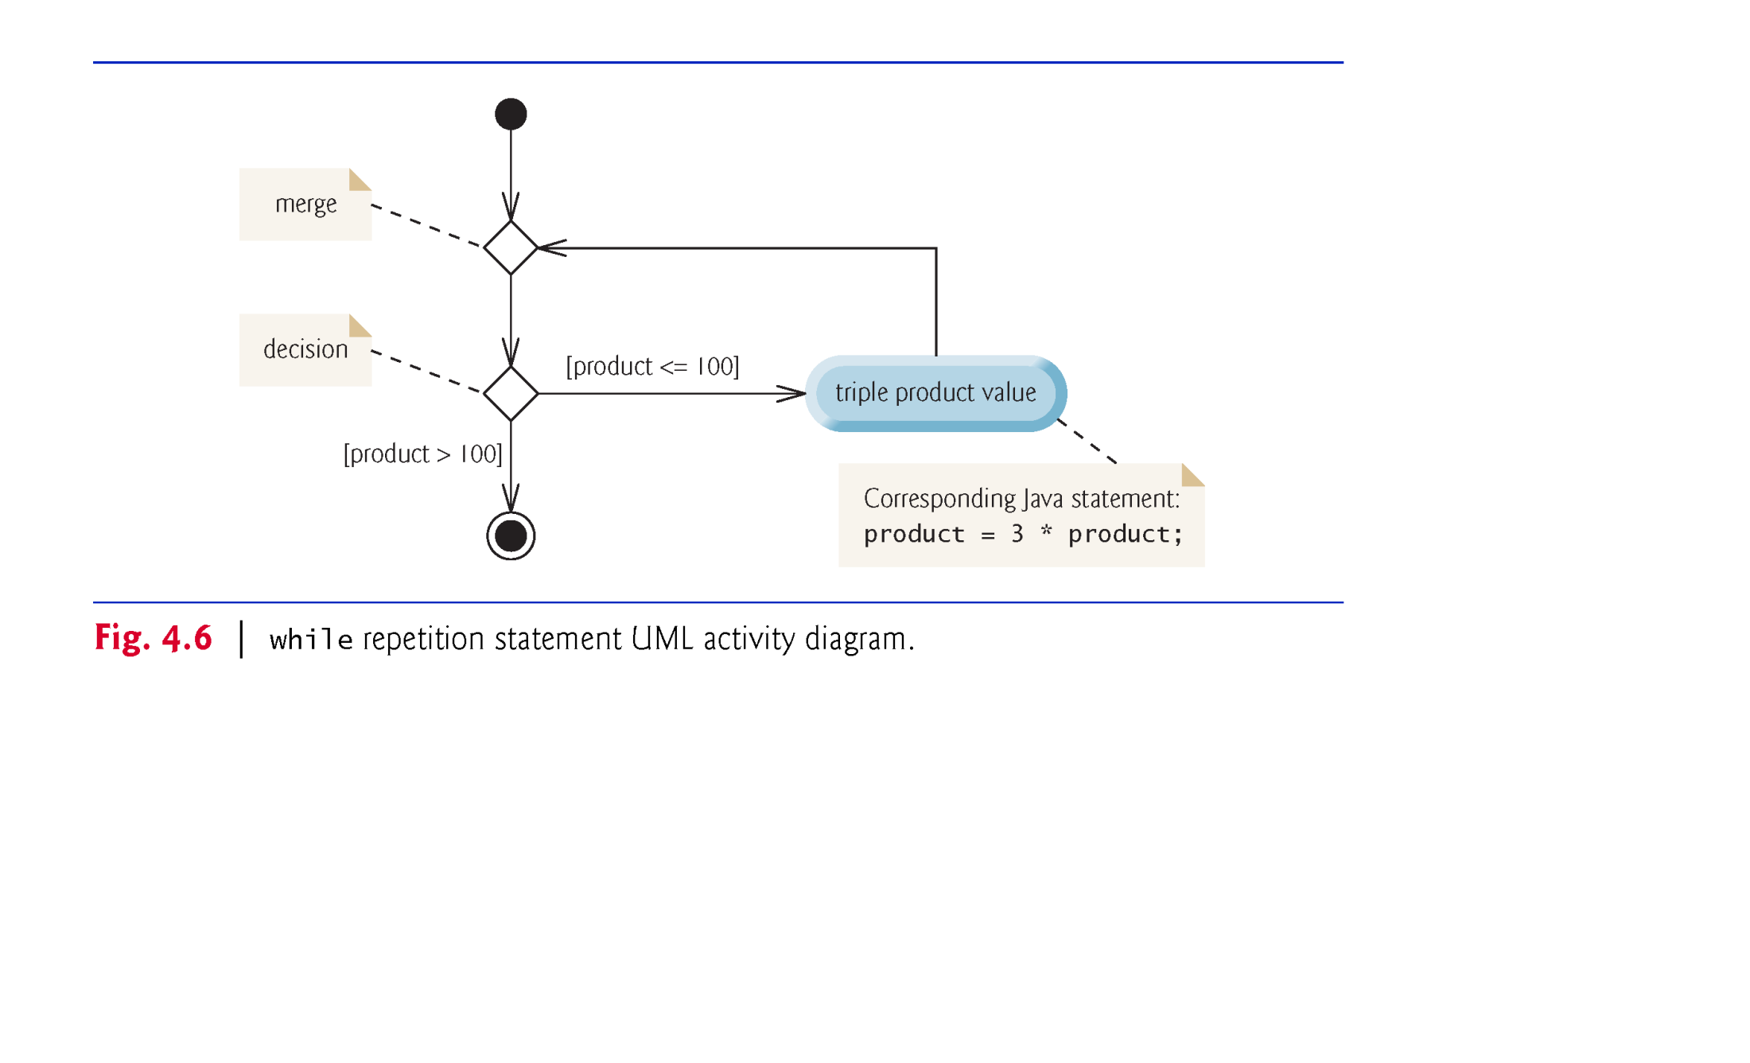
© Copyright 1992-2015 by Pearson Education, Inc. All Rights Reserved.

